Slide 1
Heat flow in welding II

Slide 2
Calculations of Cooling Rate
-Thickness of the plate to be welded directly affects the cross sectional area available for the heat flow which in turn governs cooling rate of a specific location.
-Two different empirical equations are used for calculating the cooling rate in HAZ for
a) thin plates and b) thick plates,
and these are based on:
1) number of passes required for completing the weld
2) relative plate thickness-
-According to first method, if number of passes required for welding of two plates is less than 6 then it is considered as thin plate else thick plate for selection of suitable equation to calculate cooling rate.
-Second method based on relative plate thickness is more logical as it considers thickness of the plate (h), heat input (Hnet), initial plate temperature (To), temperature of interest at which cooling rate is desired (Ti) and physical properties of plate like (specific heat C, densityᵨ).

Slide 3
Calculations of Cooling Rate
-Relative plate thickness (t) can be calculated using following equation:
h { ᵨ C (Ti – To)/ Hnet } ^ (1/2)
-When relative plate thickness (t)< 0.6, thin plate cooling rate equation is used and
-Thick plate cooling rate equation is used when (t)> 0.9. If value of (t) is in range of 0.6 to 0.9 then 0.75 is used as a limit value to decide the cooling rate equation to be used.

Slide 4
Critical Cooling Rate (CCR) Under Welding Conditions
-To determine the critical cooling rate for a steel plate of (5 mm) to be welded suitable electrode diameter is chosen first and then I and V are selected (20V, 200A, To=30 0C) for bead-on-plate (BOP) welding.
-Number of BOP welds is done using welding speed (8, 9, 10, 11, 12……mm/sec). transverse section of weld at the above welding speed is cut to measure the hardness.
-There after, hardness vs. welding speed plot is made to identify the welding speed above which sudden increase in hardness of the weld and HAZ takes place.
-This welding speed is identified as critical welding speed (say 10mm/min in this case) above which cooling rate of the weld & HAZ becomes greater than critical cooling rate.
-This suddenly increase in hardness of the weld and HAZ is attributed to martensitic transformation during welding as cooling rate becomes greater than critical cooling rate owing to the reduction in heat input (Hnet = f .V I / S ) with increase of welding speed.
-Using welding conditions corresponding to this critical welding speed for a given steel plate, critical cooling rate can be calculate using appropriate cooling rate equation.

Slide 5
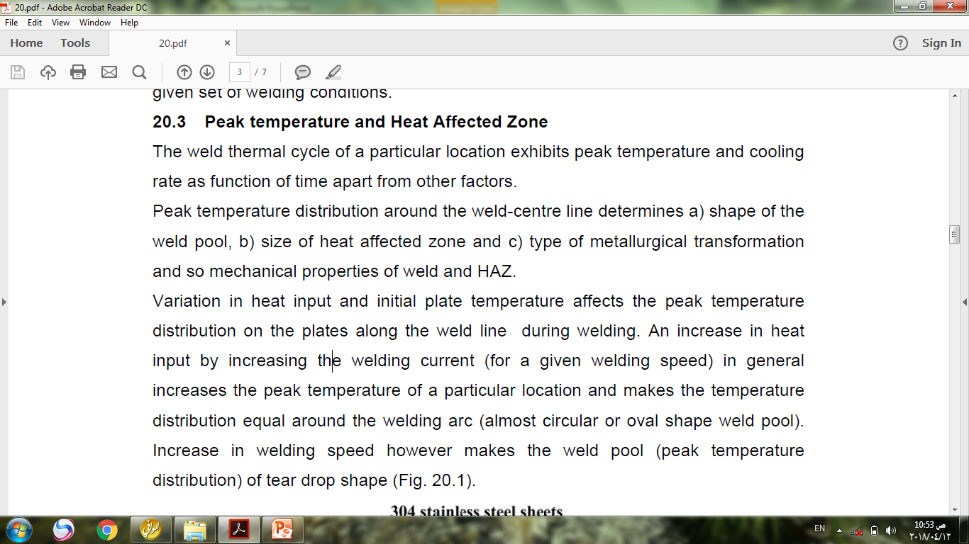
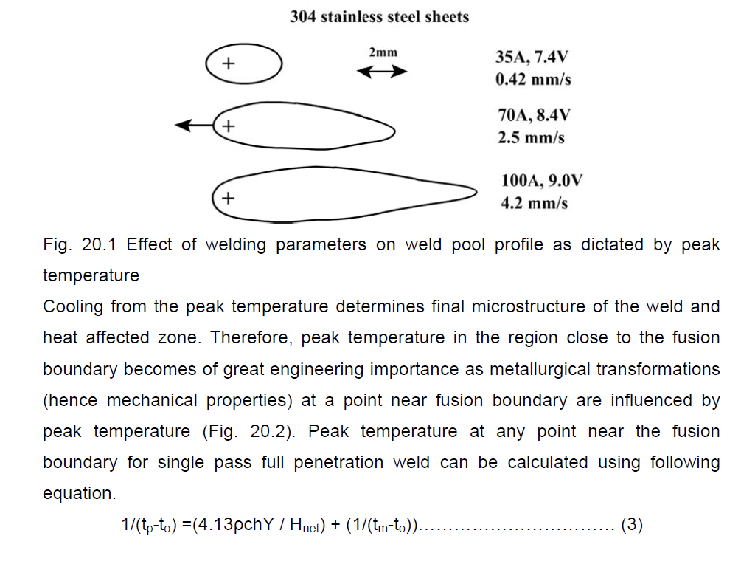
Peak Temperature and HAZ

Slide 6
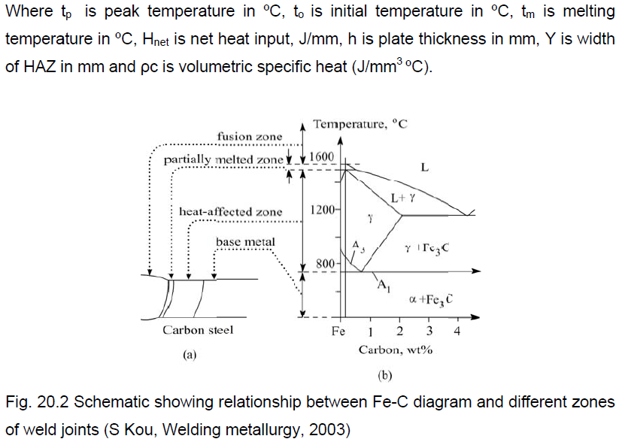
Peak Temperature and HAZ

Slide 7
Peak Temperature and HAZ
Home Work

Slide 8
Solidification Rate
-The solidification of weld metal takes place in three stages: a) reduction in temperature of liquid metal, b) liquid to solid state transformation and c) finally reduction in temperature of solid metal up to room temperature.
-Solidification time is the time interval between start to end of solidification depends on the cooling rate.
-Solidification time affects the structure, properties and response to the heat treatment of weld metal. It can be calculated using following equation:
-Above equation indicates that solidification time is the function of net heat input (Q), initial plate temp.(to), latent heat of fusion (L), thermal conductivity (k), volumetric specific heat (ᵨ c ) and melting point (tm).
-An increase in net heat input (with increase in welding current / arc voltage or reduction in welding speed) increases the solidification time and allows each phase to grow to a large extent which in turn results in coarse-grained structure of weld metal which in turn adversely affects the mechanical properties .
-Non-uniformity in solidification rates in different regions of molten weld pool also brings variation in grain structure and so mechanical properties.

Slide 9
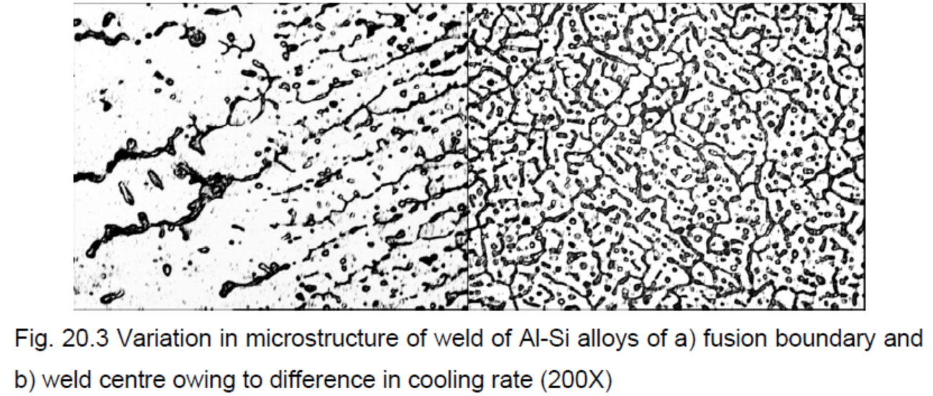
Solidification Rate
Generally, centerline of the weld joint shows finer grain structure (Fig. 20.3) and better mechanical properties than those at fusion boundary primarily because of difference in solidification times. Micrographs indicate the coarser structure near the fusion boundary than the weld center.

Slide 10
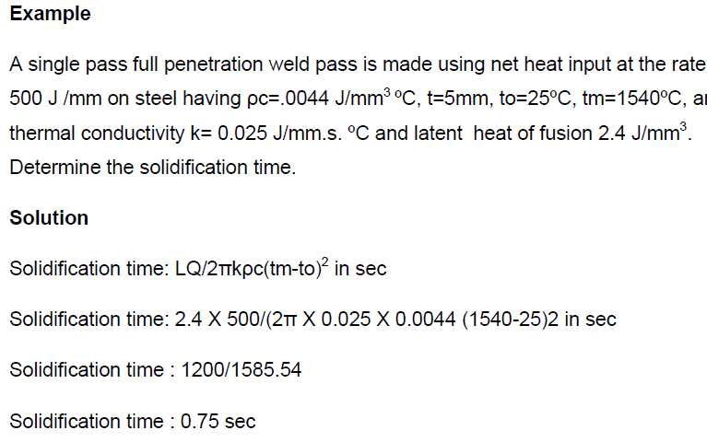
Solidification Rate

